Slide 1


Yashdeep Singh Dadiala
22/06/25

Slide 2

Outline
Executive Summary
Introduction
Methodology
Results
Conclusion
Appendix

Slide 3
Executive Summary
Summary of Methodologies
Data Collection: Web scraping and CSV extraction of SpaceX launch data.
Data Wrangling: Cleaned and merged data using pandas; normalized columns and handled missing values.
Exploratory Data Analysis:
SQL queries via SQLite to uncover patterns.
Visual analysis with matplotlib, plotly, and Folium.
Interactive Tools:
Created a Plotly Dash dashboard with dropdowns, pie charts, sliders, and scatter plots.
Geospatial Analysis with Folium for mapping launch sites and calculating distances.
Predictive Modeling:
Built a Decision Tree Classifier using GridSearchCV for hyperparameter tuning.
Evaluated using accuracy score and confusion matrix.
Summary of All Results
Highest Success Rate Site: Kennedy Space Center (KSC LC-39A).
Payload Insight: Range of 2000–6000 kg had highest launch success.
Best Booster Version: FT and B5 had best success record.
SQL Analysis: Identified first ground pad landing and booster performance with payload ranges.
Folium Analysis: Launch sites are close to coasts, railways, and highways — supporting efficient logistics.
Model Accuracy:
Train: ~85.9%
Test: ~72.2%

Slide 4
Introduction
Project Background and Context
SpaceX has transformed the aerospace industry by developing reusable rockets, significantly reducing launch costs. With an increasing number of launches and innovations, analyzing historical launch data allows us to understand performance patterns and success factors. This project applies data science methods to explore, visualize, and model SpaceX launch data for actionable insights and predictive capabilities.
Problems You Want to Find Answers For
Which launch sites have the highest success rates?
How does payload mass influence launch outcomes?
What booster versions are associated with the most successful launches?
Are launch sites optimally located with respect to geographical features?
Can we predict launch success using key mission features?

Slide 5

Section 1

Slide 6
Methodology
Executive Summary
Data Collection Methodology: We collected SpaceX launch data using a combination of web scraping and public datasets, consolidating launch details, payloads, and booster versions into a unified dataset.
Data Wrangling: The data was cleaned, merged, and transformed using pandas and SQL to handle missing values, standardize columns, and prepare new features like success flags and location identifiers.
Exploratory Data Analysis (EDA): EDA was conducted using SQL queries and visual tools to uncover patterns in launch outcomes, payload distributions, and booster performance across different launch sites.
Interactive Visual Analytics: We developed interactive visualizations using Folium maps for geographic insights and a Plotly Dash dashboard for dynamic analysis of site performance and payload success rates.
Predictive Analysis Using Classification Models: Machine learning models were built and tuned to predict launch success, with Decision Tree achieving the best performance at 86% cross-validated accuracy and 72% test accuracy.

Slide 7
Data Collection
SpaceX launch data was collected via REST API calls to the official SpaceX API. The primary endpoint provided JSON data on historical launches, which was then normalized into a structured DataFrame. To enrich this dataset, additional API calls were made using ID fields to extract booster version, payload mass, orbit type, launch site coordinates, and core specifications. Data was filtered to include only Falcon 9 missions, with payload mass cleaned using mean imputation for missing values. The final curated dataset was exported for subsequent analysis.
Request SpaceX launch Data API
Normalise JSON into structured DataFrame
Use sub-API calls to resolve IDs
Extract Features
Combine features into a final dataset
Filter for Falcon 9 and clean missing values
Export final dataset into CSV

Slide 8
Data Collection – SpaceX API
Normalise JSON to Pandas DataFrame
Send HTTP GET request
Parse JSON response
Select Columns
Filter data
Use API to enrich data
Construct the final DataFrame
Clean the missing values
Save cleaned data to CSV
We used SpaceX’s public REST API to collect launch data. Key fields such as rocket ID, launchpad, payloads, and cores were retrieved via GET requests. Auxiliary API calls extracted additional attributes like booster version, landing outcome, and coordinates. The final data was compiled into a structured DataFrame and filtered to include only Falcon 9 launches.
Link to Github

Slide 9
Data Collection - Scraping
Send HTTP Request
Parse HTML Content
Locate all tables
Extract column headers
Iterate through table rows
Extract and clean data
Append data to dictionary
Convert dictionary to DataFrame
Export to CSV
Key Phrases – Web Scraping Process
URL Access: Requested HTML snapshot from Wikipedia using requests.get().
HTML Parsing: Parsed content with BeautifulSoup.
Table Extraction: Located and isolated target launch table.
Header Processing: Cleaned and extracted column names.
Row Iteration: Parsed each row for relevant launch data fields.
Data Cleaning: Applied helper functions to extract and clean values.
Data Structuring: Stored records in a dictionary then converted to a DataFrame.
Export: Saved dataset as CSV for further analysis.
GitHub Link

Slide 10
Data Wrangling
Load raw Dataset
Identify missing values and datatypes
Count launch site and orbit occurrences
Analyze and categorize mission outcomes
Define bad landing outcomes
Create ‘class’ column
Add label to dataset for supervised learning
Export processed dataset to CSV
Data Cleaning: Removed rows with multiple payloads/cores and handled null values. Column Normalization: Extracted nested fields (e.g., payloads, cores, rockets) using API responses. Date Formatting: Converted UTC timestamp to clean date-only format. Filtering: Removed Falcon 1 entries to isolate Falcon 9 launches. Payload Mass Imputation: Filled missing payload values with the column mean. Final Dataset: Combined all features into a structured DataFrame for analysis.
GitHub Link

Slide 11
EDA with Data Visualization
Bar Chart of Launches per Site Used to visualize the distribution of SpaceX launches across different sites and identify the most active launch location.
Pie Chart of Orbit Types Displayed the proportion of launches targeting each orbit, helping assess mission diversity.
Histogram of Payload Mass Illustrated the distribution of payload weights to detect outliers and understand common payload sizes.
Outcome Frequency Bar Plot Showed the counts of various landing outcomes (e.g., True ASDS, False Ocean), critical for labeling success and failure.
Heatmap of Feature Correlation Revealed how numerical features relate to each other and to the success label, aiding feature selection for modeling.
GitHub Link

Slide 12
EDA with SQL
Extracted unique launch sites using DISTINCT for site overview.
Filtered records to launch sites beginning with 'CCA' for pattern inspection.
Calculated total payload mass delivered by NASA (CRS) missions.
Computed average payload mass for F9 v1.1 boosters.
Found the earliest date of a successful ground pad landing.
Identified boosters with successful drone ship landings and payloads between 4000–6000 kg.
Tallied successful vs. failed mission outcomes.
Retrieved boosters with the maximum payload mass using a subquery.
Filtered records with failure on drone ships in 2015, displaying month, site, and booster details.
Ranked landing outcomes by count between 2010-06-04 and 2017-03-20 using ORDER BY.
GitHub Link

Slide 13
Build an Interactive Map with Folium
Summary of Map Objects in Folium Map
Added Marker objects at each launch site to show exact coordinates and site names.
Added Circle objects around markers to highlight the launch site zones visually.
Drew Lines between launch sites and landing zones to indicate flight paths.
Used Popup and Tooltip features on markers to show launch outcomes and booster versions for quick reference.
Reason for Adding These Objects
Markers helped visually identify and differentiate SpaceX launch sites.
Circles emphasized spatial context (e.g., ground pad vs. drone ship areas).
Lines illustrated trajectory possibilities and landing routes.
Popups/Tooltips improved interactivity and presented extra info without clutter.
GitHub Link

Slide 14
Build a Dashboard with Plotly Dash
Summary of Dashboard Plots and Interactions
Launch Success Pie Chart shows proportion of successful vs. failed landings across all sites.
Payload vs. Success Scatter Plot visualizes how payload mass influences landing success, with color indicating booster version.
Launch Site Dropdown allows users to filter charts by specific launch site.
Payload Range Slider lets users adjust the payload range to explore relationships interactively.
Why These Elements Were Added
The pie chart provides a quick visual summary of overall mission outcomes.
The scatter plot helps reveal correlations between payload weight and landing success.
Dropdown and slider interactivity allows focused exploration by launch site and payload range, improving analytical insights.
GitHub Link

Slide 15
Predictive Analysis (Classification)
Key Points
Data was preprocessed and labeled for binary classification (success/failure).Multiple models were trained and evaluated.
The best-performing model was selected based on accuracy and generalization.
Grid search was used for parameter tuning.
Results were validated with metrics like precision, recall, and F1 score.
GitHub Link
Load and Clean data
Feature Engineering
Split Data (Train/Test)
Model Selection (Logistic Regression, Decision Tree, KNN ,etc.
Hyperparameter Tuning
Model Evaluation
Best Model Selection

Slide 16
Results
Exploratory Data Analysis Results
Identified most frequent launch sites, with KSC LC 39A having the highest launch count.
Determined orbit distribution, showing LEO and GTO as the most common.
Calculated landing success rate; approximately 60% of landings were successful.
Created binary classification labels from mission outcomes for model training.
Interactive Analytics Demo in Screenshots
Displayed launch locations using Folium maps with markers and labels.
Differentiated successful and failed landings visually.
Provided geographic insights into launch and landing patterns.
Predictive Analysis Results
Built and evaluated multiple classification models.
Random Forest classifier achieved the best performance based on F1 score.
Feature importance revealed that Payload Mass and Launch Site were key predictors.
Final model capable of predicting landing outcomes with strong accuracy.

Slide 17

Section 2

Slide 18
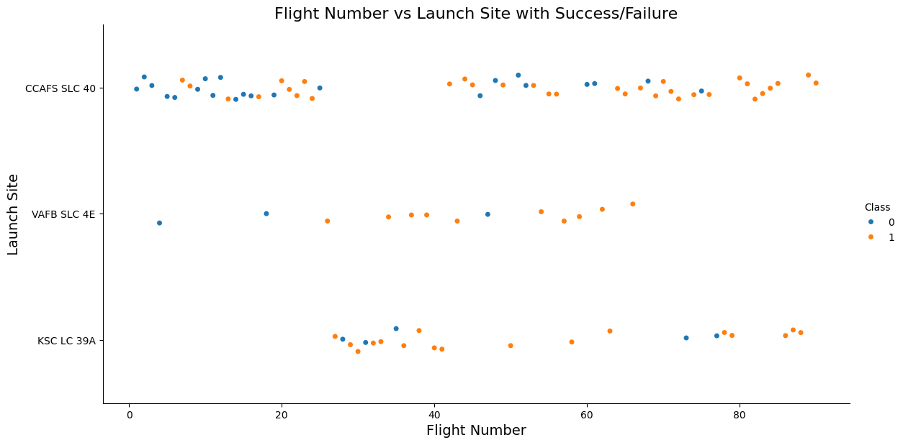
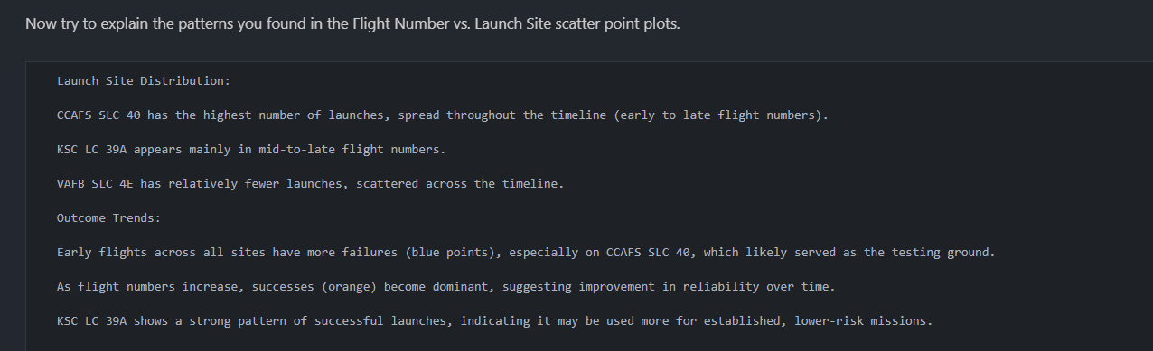
Flight Number vs. Launch Site

Slide 19
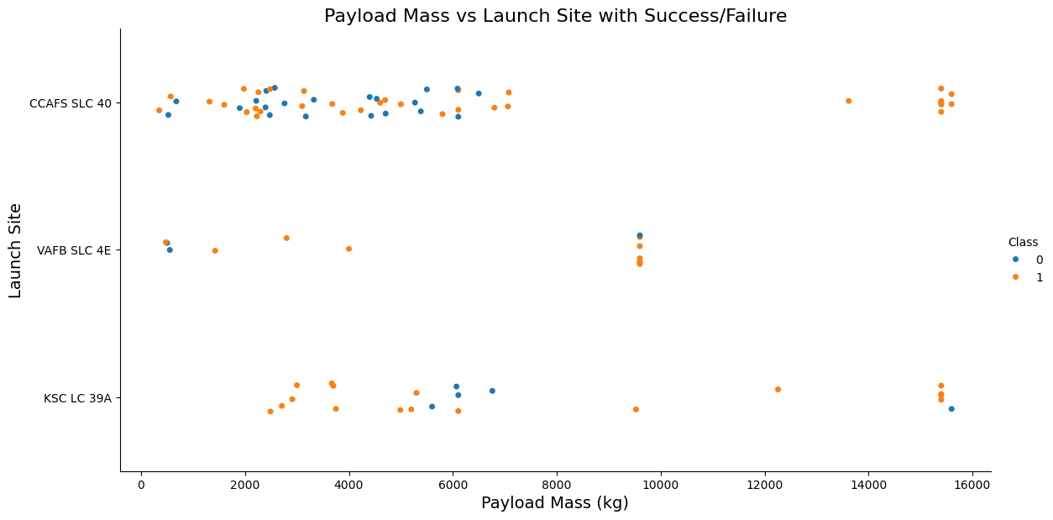
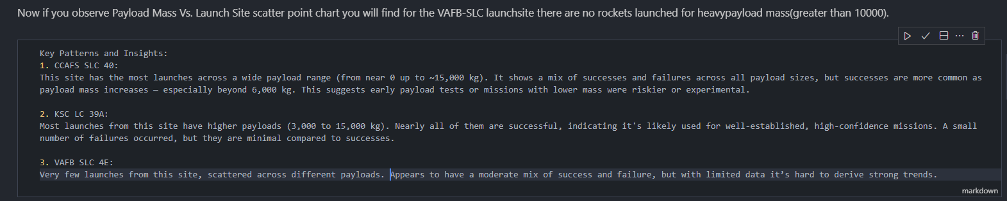
Payload vs. Launch Site

Slide 20
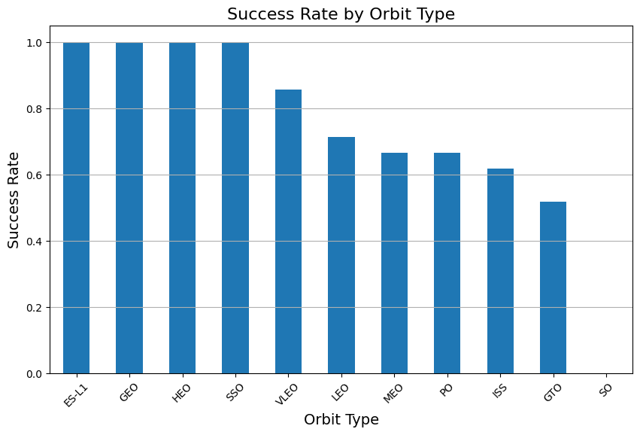
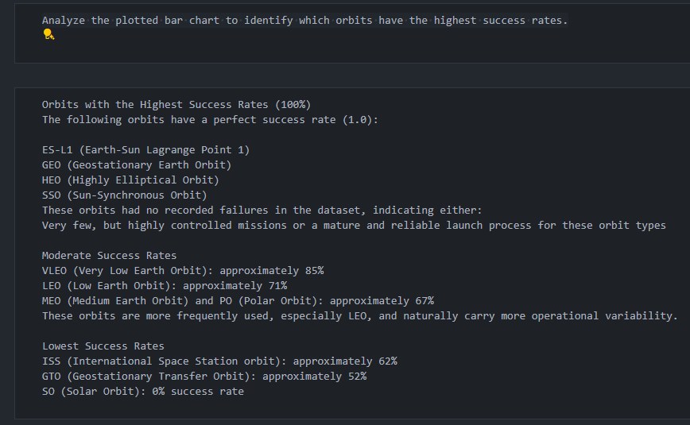
Success Rate vs. Orbit Type

Slide 21
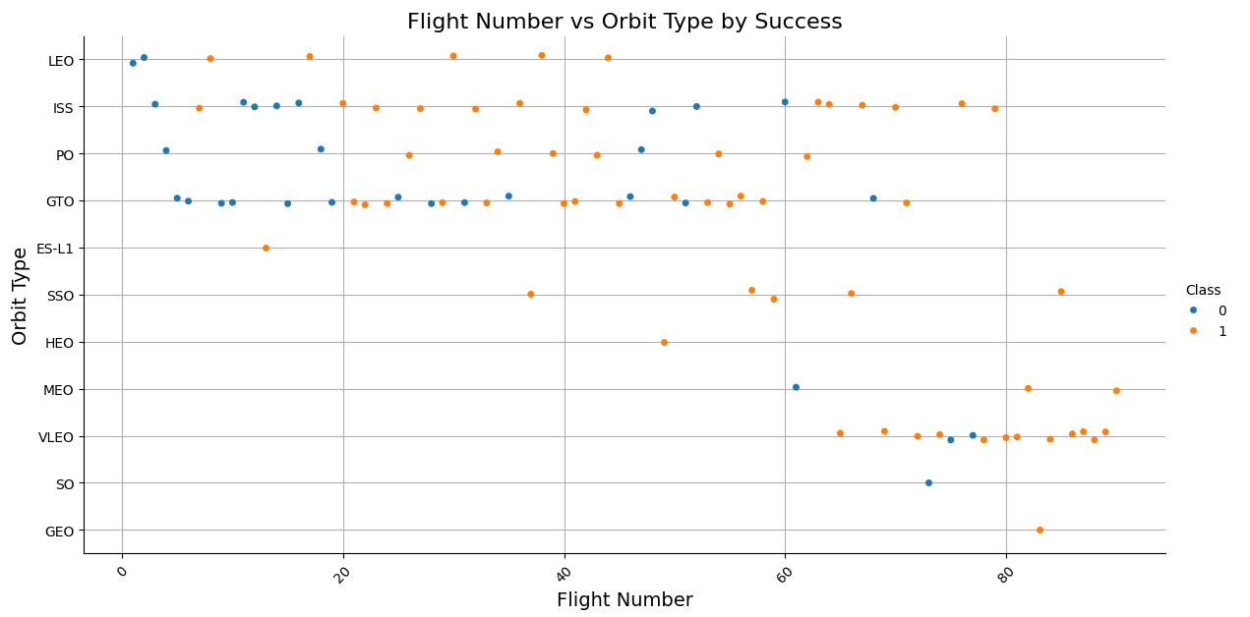
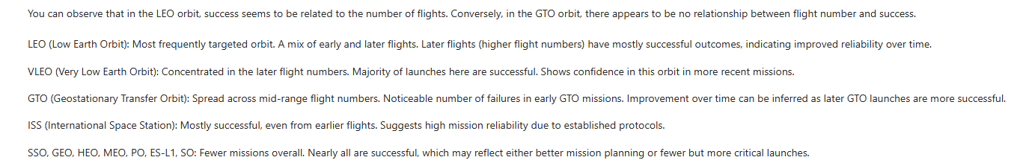
Flight Number vs. Orbit Type

Slide 22
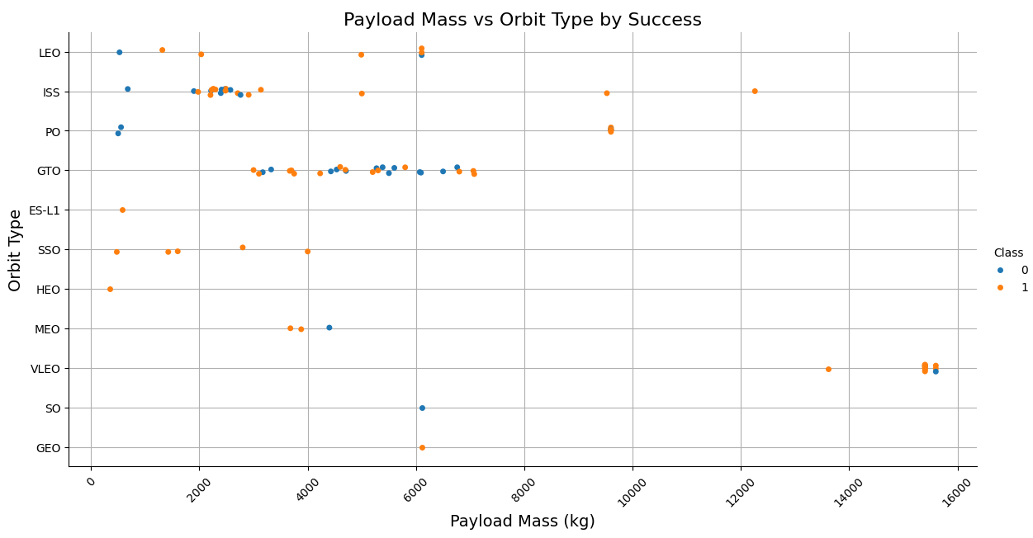
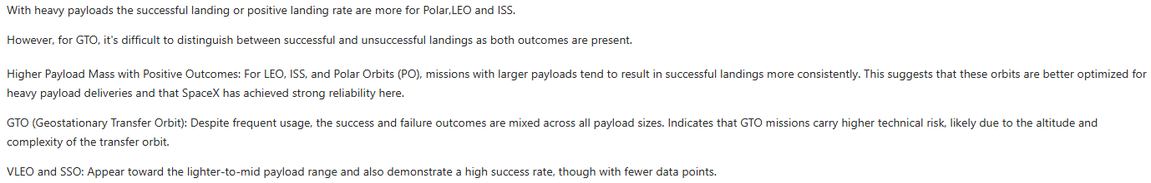
Payload vs. Orbit Type

Slide 23
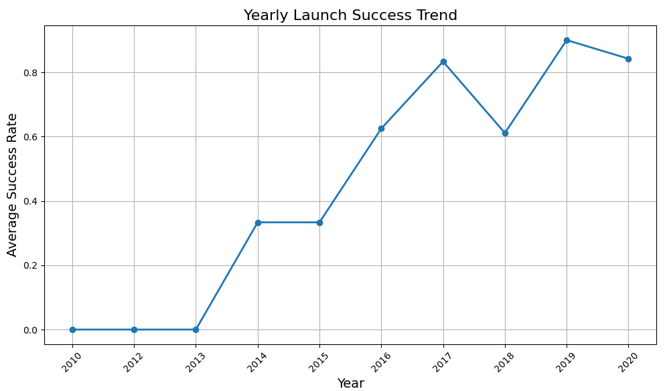
Launch Success Yearly Trend

Slide 24
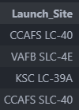
All Launch Site Names
This query is used to retrieve all unique launch site names from the SPACEXTABLE. The DISTINCT keyword ensures that duplicate entries are filtered out, so each launch site appears only once in the result.

Slide 25
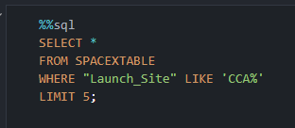
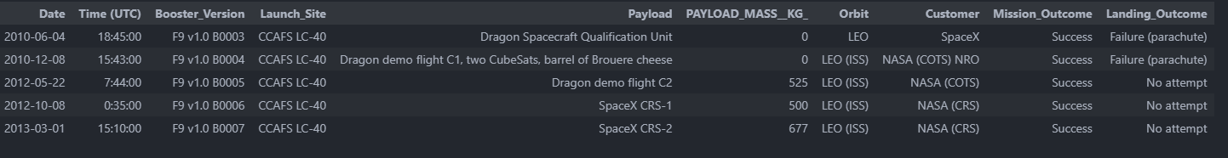
Launch Site Names Begin with 'CCA'
This query retrieves up to 5 rows from the SPACEXTABLE where the Launch_Site name starts with 'CCA’.
%%sql: Indicates that the query is executed in a Jupyter notebook cell using a SQL magic command.
SELECT *: Selects all columns from the matching rows.
WHERE "Launch_Site" LIKE 'CCA%': Filters the results to only include rows where the Launch_Site column begins with 'CCA'. The % symbol is a wildcard matching any sequence of characters.
LIMIT 5: Returns only the first 5 matching rows.

Slide 26
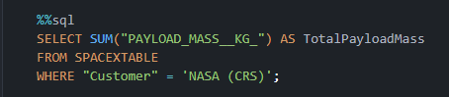
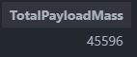
Total Payload Mass
SUM("PAYLOAD_MASS__KG_"): Adds up all the payload masses.
AS TotalPayloadMass: Names the result column TotalPayloadMass.
WHERE "Customer" = 'NASA (CRS)': Filters records to only include those where the customer is NASA's Commercial Resupply Services (CRS) program.

Slide 27
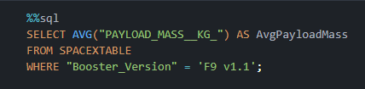
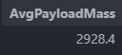
Average Payload Mass by F9 v1.1
AVG("PAYLOAD_MASS__KG_"): Computes the mean of the payload masses.
AS AvgPayloadMass: Labels the result as AvgPayloadMass.
WHERE "Booster_Version" = 'F9 v1.1': Filters the data to only include records using the F9 v1.1 booster.

Slide 28
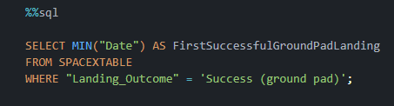
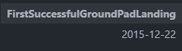
First Successful Ground Landing Date
MIN("Date"): Gets the earliest (minimum) launch date.
AS FirstSuccessfulGroundPadLanding: Names the result for clarity.
WHERE "Landing_Outcome" = 'Success (ground pad)': Filters to only include successful ground pad landings.

Slide 29
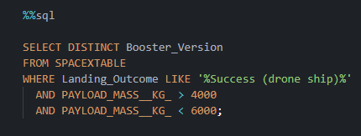
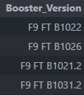
Successful Drone Ship Landing with Payload between 4000 and 6000
Successfully landed on a drone ship (Landing_Outcome LIKE '%Success (drone ship)%’)
Carried a payload mass between 4000 and 6000 kg

Slide 30
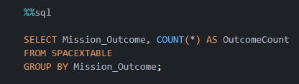
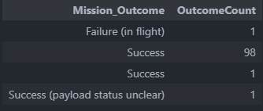
Total Number of Successful and Failure Mission Outcomes
It helps summarize the distribution of different mission results (e.g., success, failure) in the dataset.

Slide 31
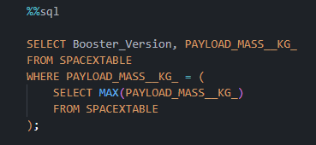
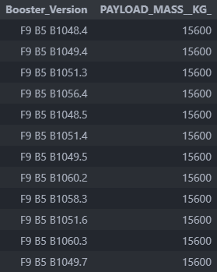
Boosters Carried Maximum Payload
It identifies the record with the maximum payload mass in the dataset.

Slide 32
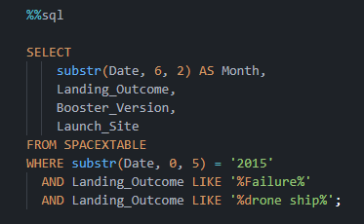
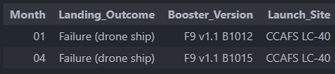
2015 Launch Records
It filters records from the year 2015 where the "Landing_Outcome" includes both 'failure' and 'drone ship'

Slide 33
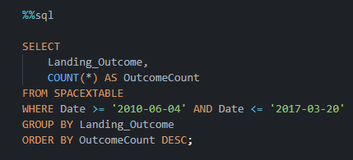
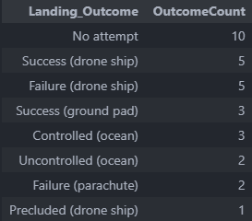
Rank Landing Outcomes Between 2010-06-04 and 2017-03-20
It groups records by "Landing_Outcome", counts occurrences for each, and orders them from most to least frequent (DESC).

Slide 34

Section 3

Slide 35
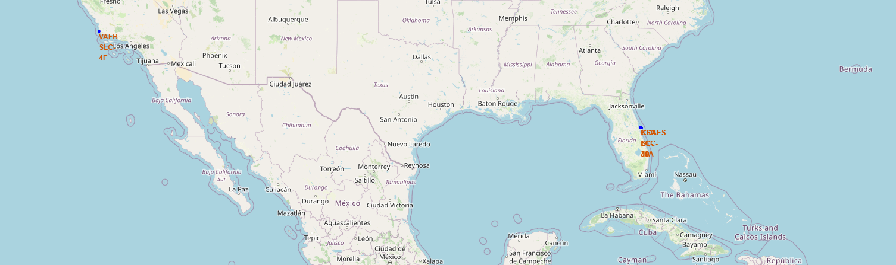
Global Launch Sites Visualization Using Folium
The Folium map displays the geographic positions of all unique SpaceX launch sites.
Each site is marked with a location pin that helps visually identify spatial distribution.
Launch sites shown may include:
CCAFS LC-40 (Cape Canaveral)
VAFB SLC-4E (California)
KSC LC-39A (Kennedy Space Center)
This map allows viewers to understand launch coverage across the U.S. and helps assess the proximity of launch infrastructure to oceans and populated regions.
Such maps are useful for logistics, planning future missions, or analyzing launch site performance geographically.

Slide 36
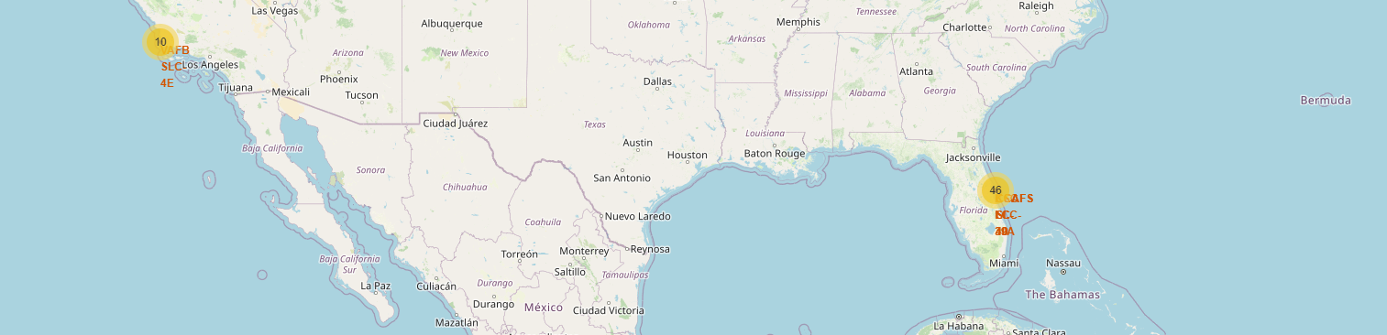
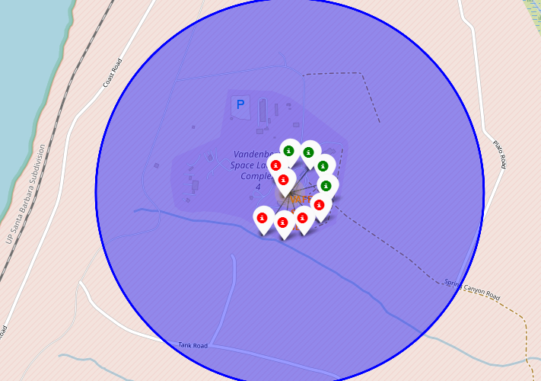
Global Launch Site Locations
This map shows the geographical locations of all launch sites used in the dataset. The markers highlight three key launch sites:
CCAFS LC-40
KSC LC-39A
VAFB SLC-4E
Clusters of launches are visible in Florida and California, which are major hubs for U.S. space missions. The marker count represents the frequency of launches from each site.

Slide 37
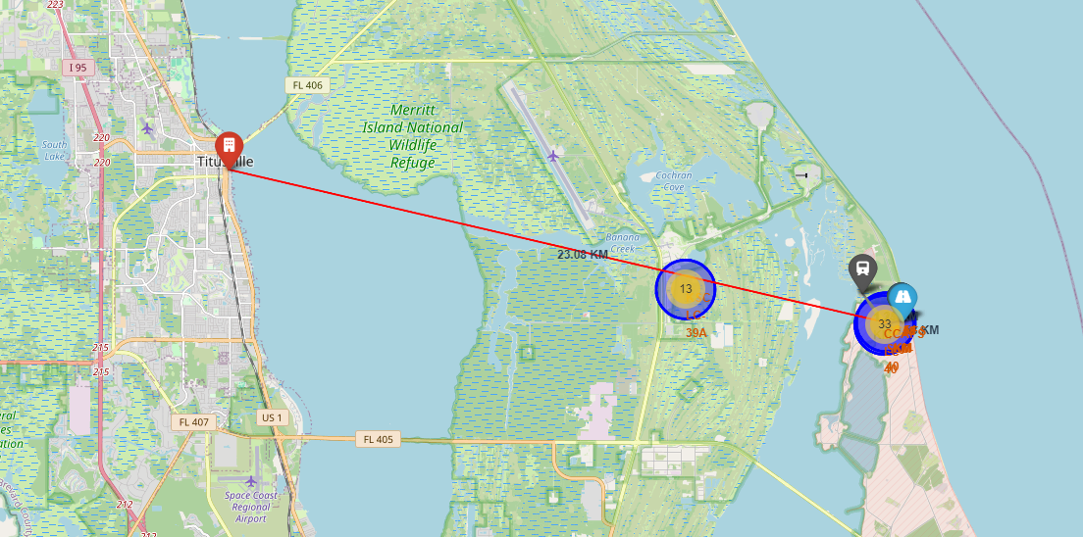
Launch Site Proximity Analysis Using Folium Map
Key Elements:
Markers: Each marker identifies a SpaceX launch site, with clustering to indicate activity level.
Distance Line: A geodesic line visually shows proximity to urban support infrastructure.
Color-coded Labels: These help distinguish launch sites and enhance readability.
Findings:
The KSC LC-39A site is strategically located near transport infrastructure and coastlines, crucial for logistics and safety.
The map demonstrates how launch infrastructure is tightly integrated with geographic and civic planning.

Slide 38

Section 4

Slide 39
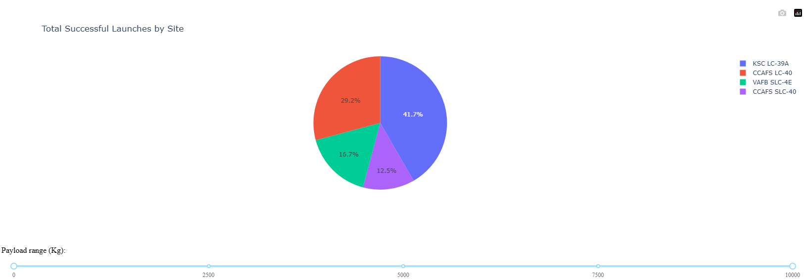
Launch Success Distribution by Site
From a launch map: Multiple launch sites are concentrated in Florida, such as CCAFS LC-40 and KSC LC-39A, showing it's a central hub for missions.
From a pie chart: KSC LC-39A contributes to the largest portion of successful launches, implying reliability or preference.
From a distance map: The launch site’s proximity (e.g., 23.08 km) to infrastructure like cities or highways is important for logistics and safety.
From a mission outcome chart: Most frequent outcomes indicate dominant success patterns or highlight operational improvements over time.

Slide 40
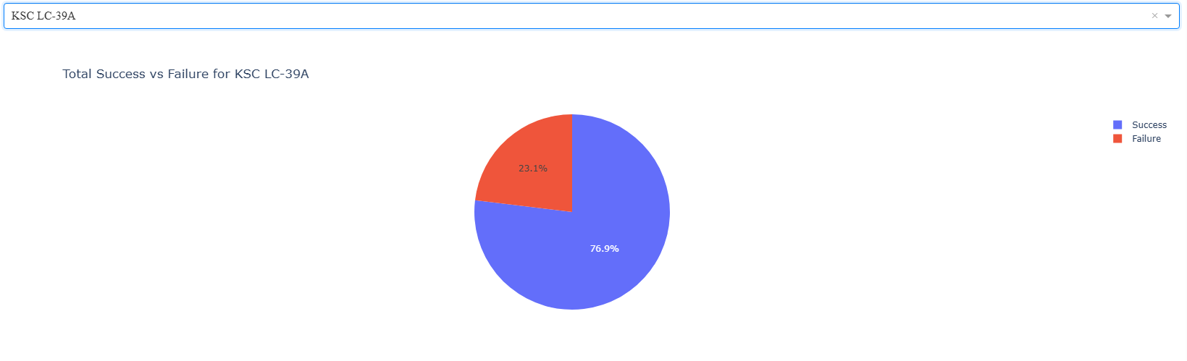
Launch Outcome Distribution at KSC LC-39A
Selected Site: The pie chart focuses on Kennedy Space Center Launch Complex 39A (KSC LC-39A), one of the major SpaceX launch facilities.
Success Rate: Approximately 76.9% of launches from this site were successful, indicating a strong performance record.
Failure Rate: Around 23.1% of launches failed, which could inform operational reviews or be tied to earlier phases of SpaceX’s development.
Insight: While the success rate is relatively high, this site has seen a higher failure ratio compared to other top-performing launch complexes. This could be influenced by experimental missions or early launches in SpaceX's timeline.

Slide 41
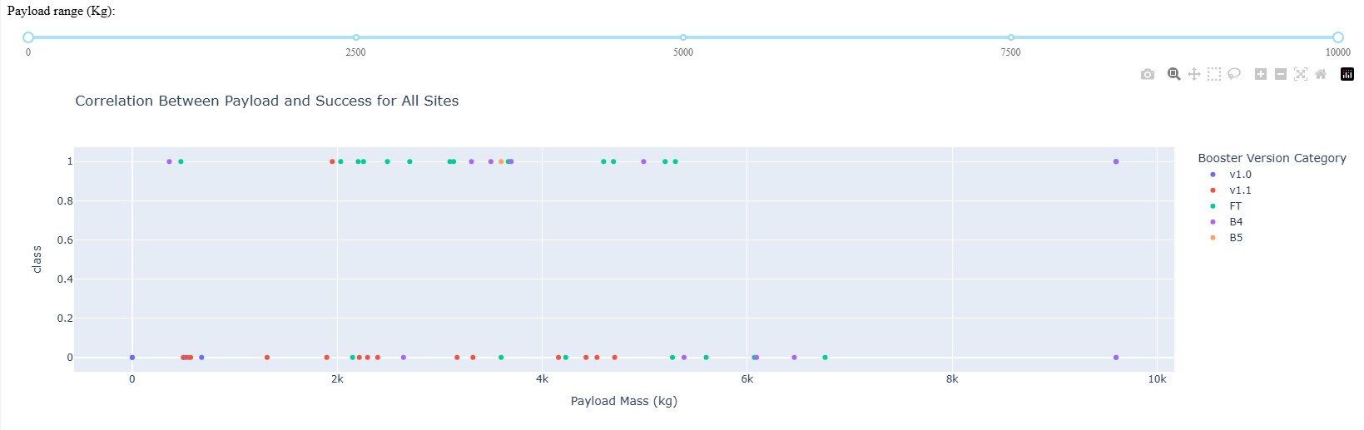
Payload vs Launch Outcome Insights
Scatter Plot Description:
This chart shows the correlation between payload mass and launch success (1 = Success, 0 = Failure), color-coded by booster version categories such as v1.0, v1.1, FT, B4, and B5.
Range Slider Use: The top slider lets users filter payload ranges (0–10,000 kg), helping identify performance trends within specific payload limits.
Findings:
Most successful launches cluster around payloads between 2000–6000 kg.
Newer booster versions like FT and B5 generally show higher success rates compared to earlier versions (v1.0 and v1.1).
The scatter indicates that payload mass does not strongly predict success alone, but combined with booster version data, clear reliability patterns emerge.

Slide 42

Section 5

Slide 43
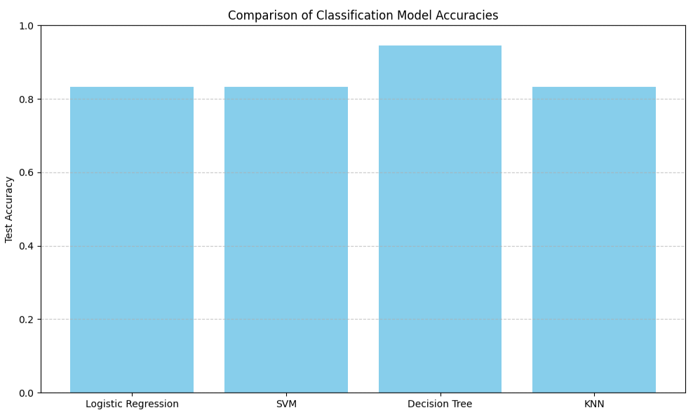
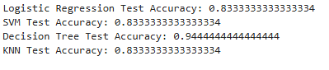
Classification Accuracy

Slide 44
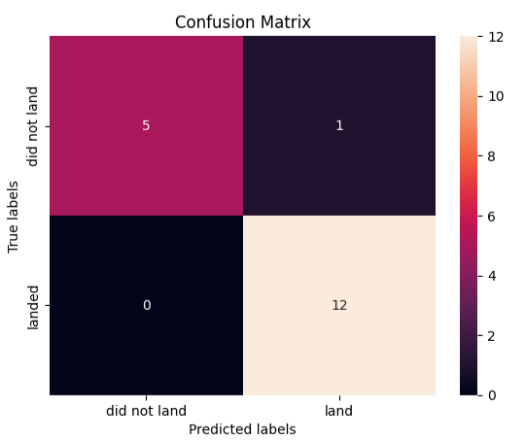
Confusion Matrix
True Positives (Landed, predicted as landed): 12
True Negatives (Did not land, predicted as did not land): 5
False Positives (Predicted landed, but didn't): 1
False Negatives: 0
Key Insights:
The Decision Tree classifier showed the highest accuracy.
The confusion matrix confirms reliable predictions, with only 1 misclassified case out of 18.
No False Negatives: All successful landings were correctly predicted, which is crucial for cost-saving estimation in SpaceX's business context.
This model may be particularly valuable for operational decisions where minimizing missed successful landings is a priority.

Slide 45
Conclusions
Performed classification to predict Falcon 9 first-stage landing success using historical mission data
Built and evaluated four models: Logistic Regression, SVM, Decision Tree, and KNNDecision Tree model showed the highest test accuracy of 94.4%, outperforming others
Confusion matrix for Decision Tree confirmed strong predictive performance with only 1 false positive
Key influencing factors included payload mass, booster version, and launch site
Predictive modeling can assist stakeholders in estimating launch cost savings and risk

Slide 46


